Slide 3
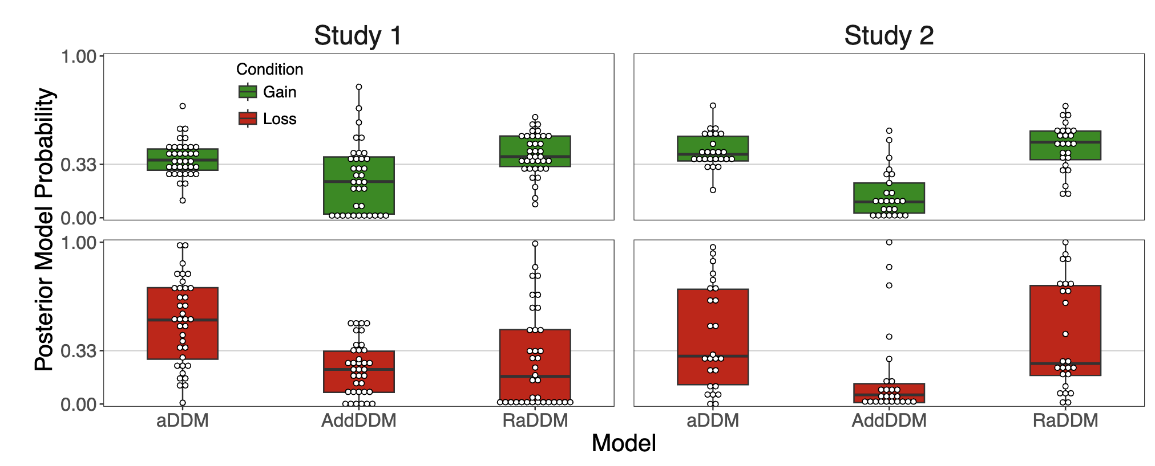
Mistake: set reference point too low

Slide 4
If reference point = minimum w/in condition, RaDDM is worst performing in Study 1. This is true even if we let theta<0 (leakage).

Slide 5
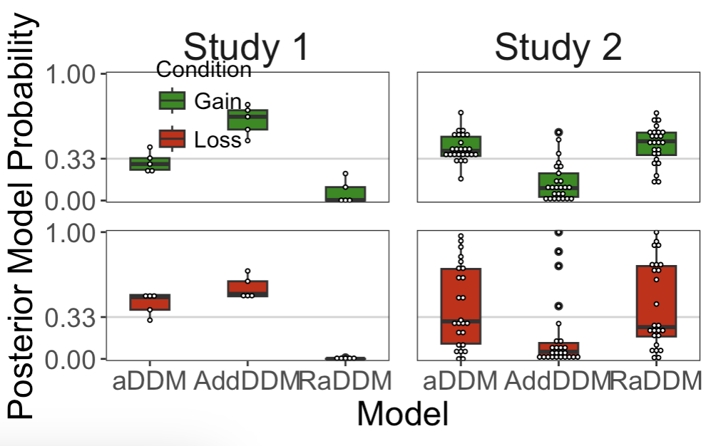
Ref pt = minimum

Slide 6
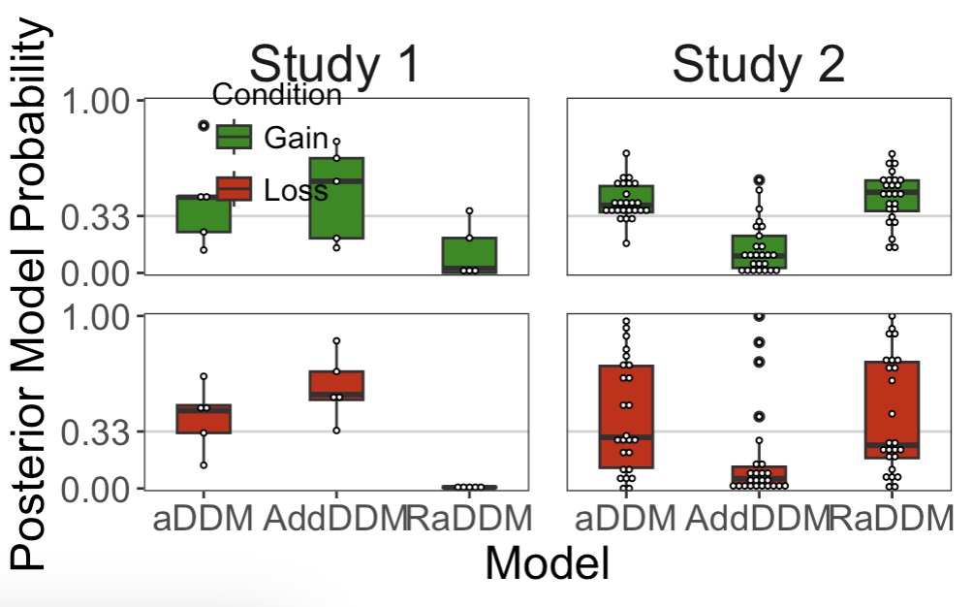
Ref pt = min AND leakage

Slide 7
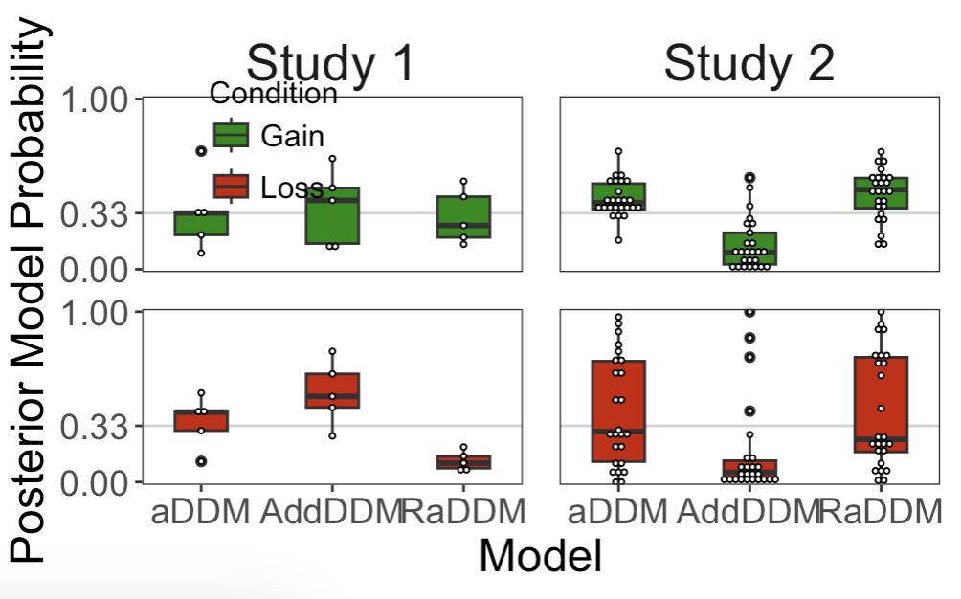
But if we set the ref pt slightly lower so we’re accumulating strictly positive signals

Slide 8
Why do I still think it’s the RaDDM?

Slide 9
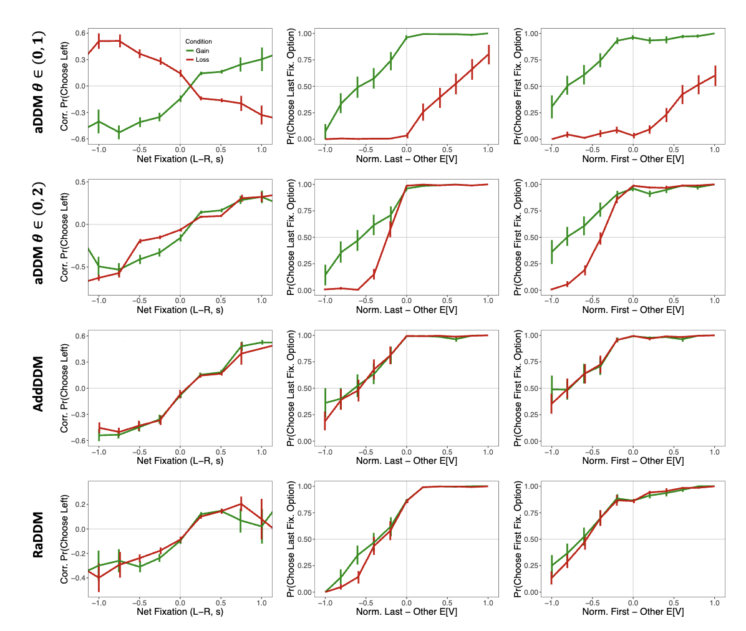
Predictions of RT(OV)

Slide 10
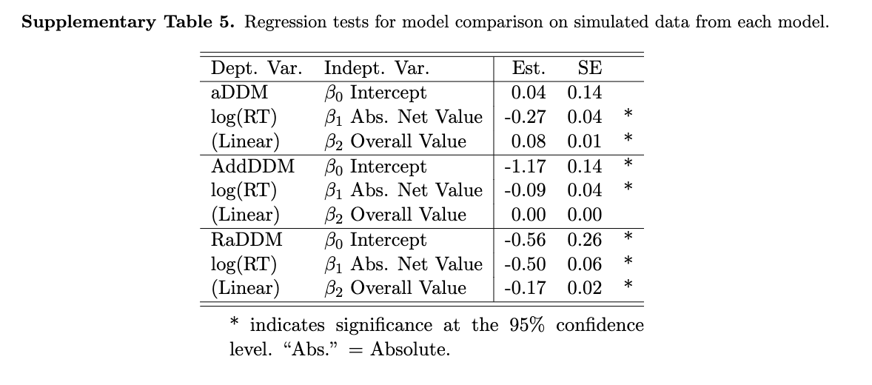

Slide 11
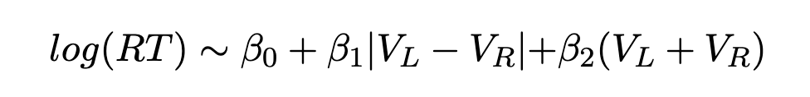
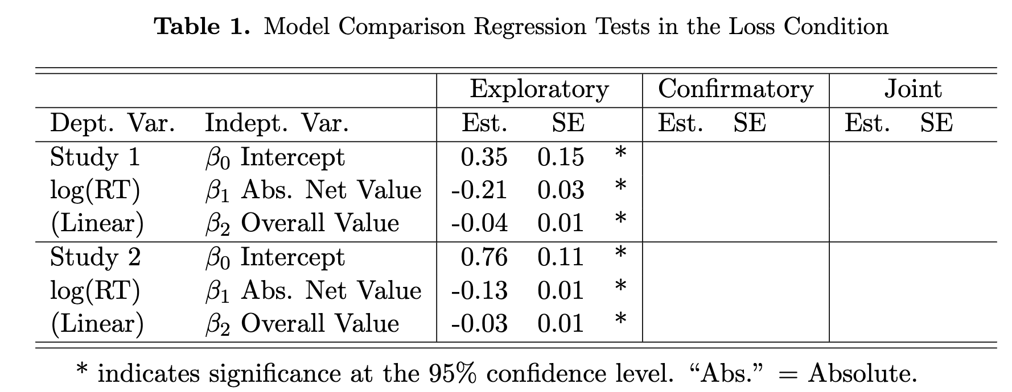
RT(OV) in the data

Slide 12
About the RaDDM fit

Slide 13
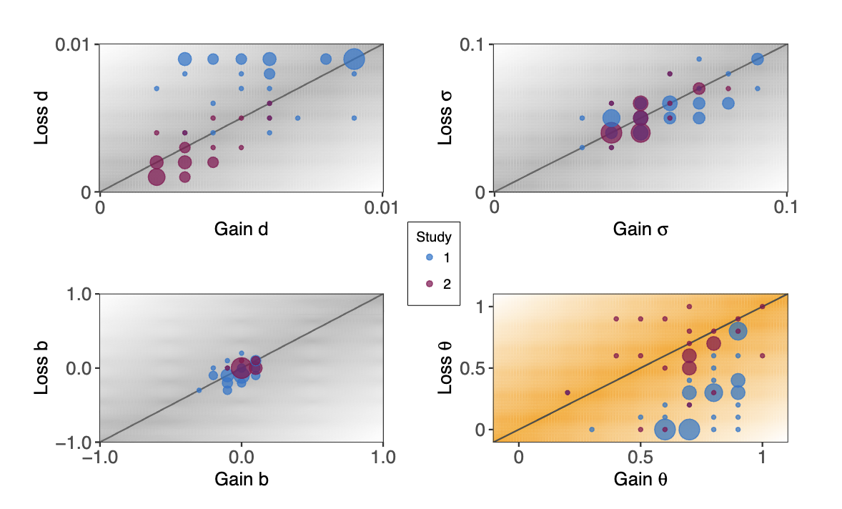
With mistake

Slide 14
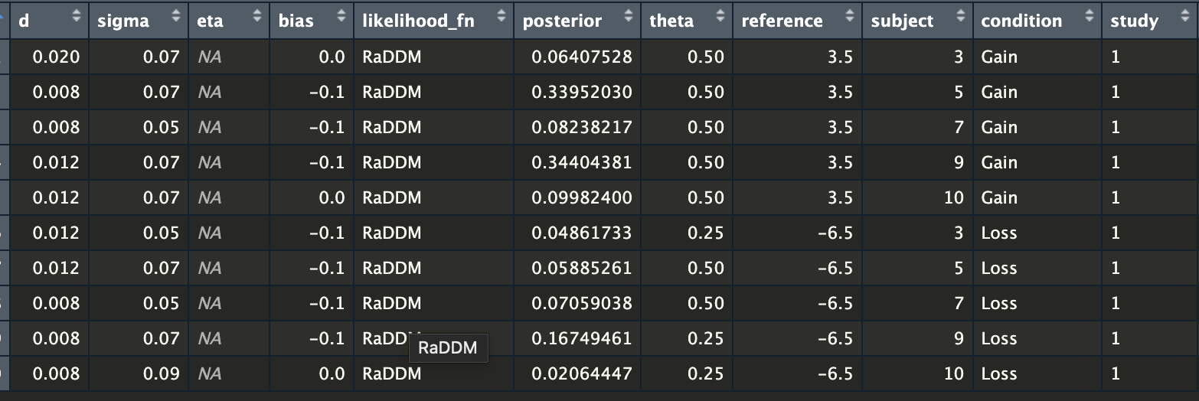
w/o mistake

Slide 15
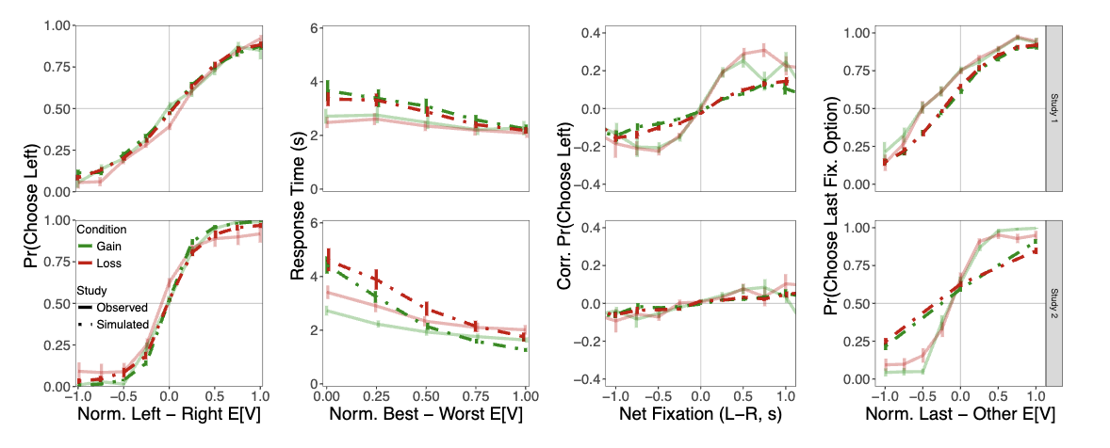
Sims with mistake

